Slide 1
COMESA DIGITAL RETAIL PAYMENTS PLATFORM

Slide 2










Key Strategic Partners
Program Implementation Unit
Open-source, Inclusive and Instant Payment System Technology
Partner
Common Market for Eastern and Southern Africa
Technical Implementation Partners
COMESA Clearing House
Notes:
[JP] Key Partners
The CBC would like to acknowledge the particular sponsors and partners in delivering the DRPP

Slide 3



































Early Adopters and Contributors
Early Participants
Regulatory WG
Technical & Standards WG
Commercial WG

Slide 4








Challenges Faced By Entrepreneurs
Lack of Political Will i.e. No Deliberate Policies
Lack of Market Intelligence and Updated Information
Lack of Supportive Infrastructure
Lack of Exposure to Necessary Skills
High Cost of Transactions
Access to Finance

Slide 5



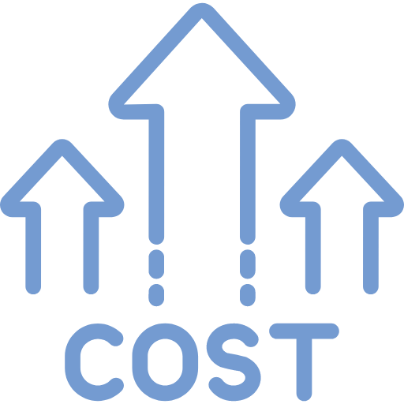

Challenges in Cross Border Payments
Transparency
Currency exchange risks
High transaction costs and slow processing
Regulatory and compliance issues

Slide 6
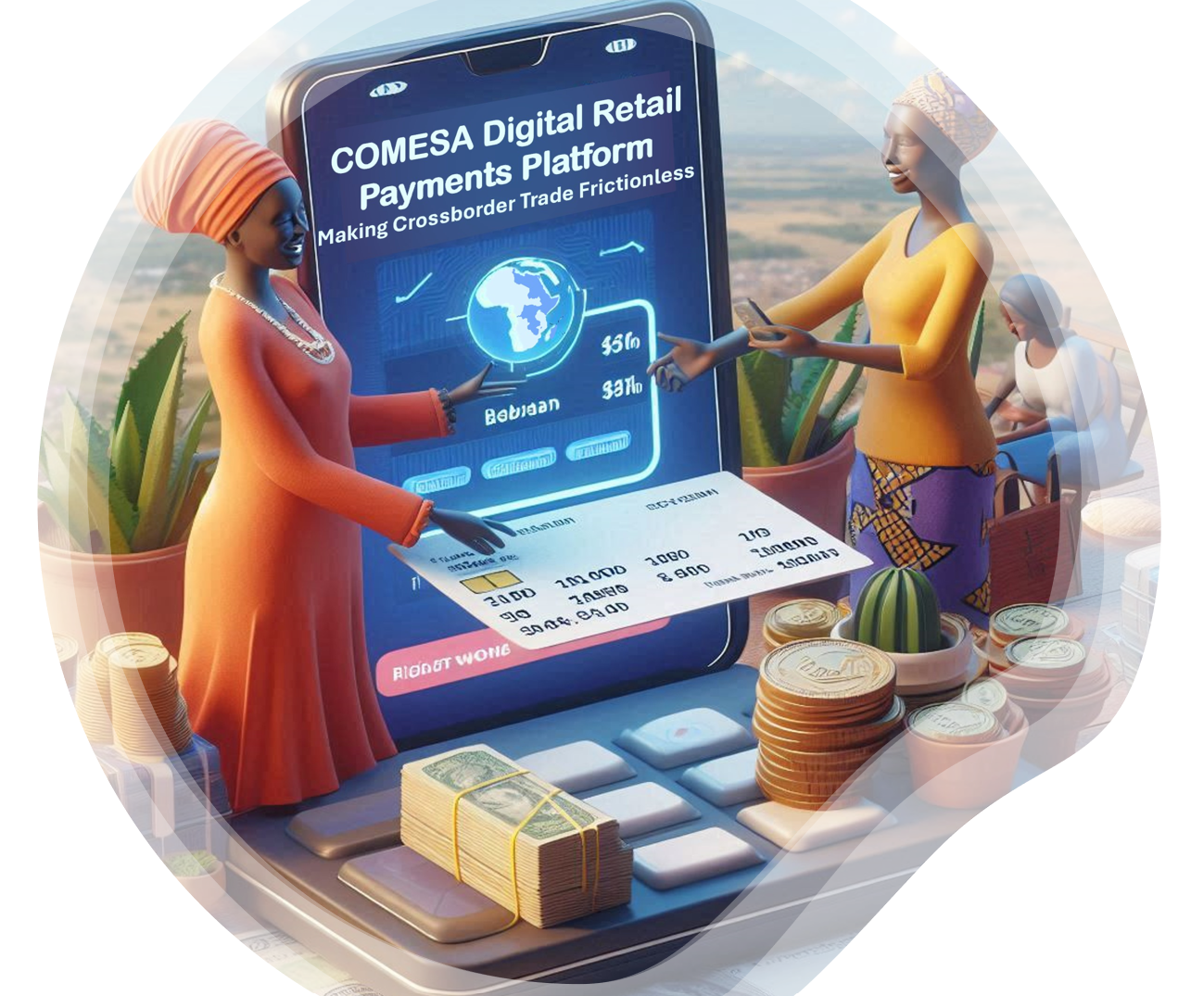





Regional Outcomes
Equitable inclusion of citizens and all classes of traders
Participation of MSMEs in formal Regional Trade
Increased Volumes of cross-border Transactions
Scaled access for Forex Providers
Increased visibility of African Products within the Regional Markets
Notes:
[JP] Program Vision / Mission Objectives [JP]
The DRPP aims to improve interregional trade and financial inclusion by the formation of regional payments rails that provides for real-time clearance of payments, central bank based settlement and cross-currency services by commercial players (aka Forex Service Providers, FPSs) which will have the benefit of scaled access to all participating jurisdictions as the they authorised to, meaning that corridors which would previously have been prohibitively costly to enter can now be services without the infrastructure costs associated with establishing a new market.

Slide 7
Value Proposition
As a Financial Institution…
1.⁠ ⁠Market Expansion
The DRPP opens a vast market to offer integration services to a wide range of financial institutions and businesses across the COMESA region.
2. Revenue Generation
Can generate revenue in scaled payment and financial services.
3. ⁠⁠Expanding Cross-border/Cross-Currency offering
Either as FI or Forex Provider, the design minimises risks and reduces costs of operating cross-border while scaling the market access.
4. Shared Target Market
Receiving and sending funds to other participants customers means a possible growth in transactions. Remember when mobile networks allowed cross network phone calls?
5.Capacity Building
Participation in the DRPP enhances skills and knowledge in digital payments, fraud management, and regulatory compliance, strengthening capabilities and competitiveness.
As a Customer of FI that Participates…
For example, Traders
Local currency approach
Affordability
Instant and inclusive payments
Capacity building
Wide geographical reach
Interoperability
Market intelligence access
Security
Value added services
Access to finance
Notes:
Value accruing to the Financial Institution by being able to offer their end users these services

Slide 8
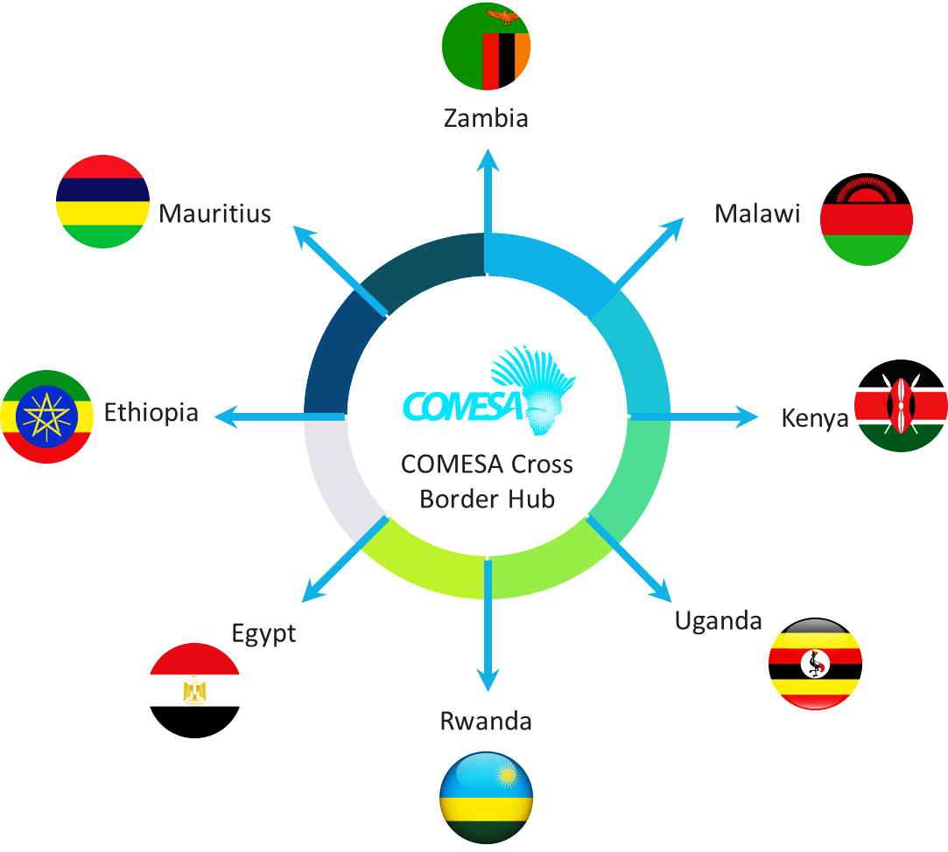





DRPP - Within the Ecosystem
DRPP administrative Boundary
Regional
IIPS
Settlement
Entity
$
FX
Provider
FRMS /
eCommerce
Source Country
Destination Country
Benefits of a hub implementation
Connection to the regional implementation needs to be establish once to reach the other participants
Payments can settle in Central Bank money, the safest form of money
All corridors can be covered, as opposed to those of only commercially viable
Proxy
Proxy
Source
DFSP
National IIPS
National
IIPS
Destination DFSP
Payee
Payer
The source country is connecting to the regional hub via a proxy.
Payments are settled using Central Bank money.
FX is managed at the regional hub to create competition.
The planned Fraud Management system connects to the regional hub, with visibility of the trends to national jurisdictions.

Slide 9
Realising DRPP
Jurisdictional Stakeholders
Central Banks and Regulators
Merchant and Financial Service Associations
🡪 Scheme Governance
Industry and regulatory representation to capture market advisory information into governance and operational models
Regulatory, Technical and Standards and Commercial Working Groups
🡪 Governance and Operating Rules
Working Groups
Scheme Management
Staging Platform is in Place
Pre-approval “fake-money on real-rails” in preparation for regulatory approval
Establishing Soft Launch Capability
Participant Engagement
National Switch/DFSP Participation Training for IIPS compliance
Sponsored “early adopters” participation to help develop the operating procedures
Notes:
[JP] Implementation/Realisation Approach
For this scale of regional initiative, the alignment of stakeholders and complexity in the regulatory and technical space need to be well managed. This calls for a parallel works streams executing in and iterative and incremental approach being taken to minimise program risks and efficient use of resources,
Therefore, there are stakeholder outreach missions with jurisdictional regulators and central banks, Participant engagement programs through Working Groups on A, B, C and the Technical Build and rollout to the initial “early adopter” co-hort.

Slide 10
DRPP Roadmap
Build (pre-approval)
2024 H2
Soft/Rolling Launch 2025 Q1
2nd Roll-out Phase 2025 H2
3rd Roll-out Phase 2026
Structuring the Scheme
Technical Realisation
Early Adopter cohort
2 Jurisdictions
Settlement Mechanisms piloted
Within approved jurisdictions
Expand participation
3-8 Jurisdictions
Migration from Direct DFSP to National IIPS
Expand Participation
9-15 Jurisdictions
Ongoing migration to National IIPS participation
FRMS service incorporation
Expand Participation
16-21 Jurisdictions
Ongoing migration to National IIPS participation
Additional Use Cases
CCCBG Overall Authorisation for Pilot
Jurisdictional Regulatory Approval
Notes:
[JP] DRPP Roadmap
While sequential execution of the Build and Soft launch phases allow for testing and refinement of functional, operational and regulatory models without overwhelming the program resources. Proceeding with appropriate care means that we can build cumulative confidence and trust in the solution while also iterating on the service offering to make sure that it is meeting market need and regulatory expectations.
It is also true that if successful, the enthusiasm to participate might be such that the only limiting factor will be the jurisdictional approval from each member state.

Slide 11

Mojaloop Platform Enhancements
The Inter-Scheme, Cross-currency and ISO 20022 workstreams have been implemented:
The discovery, agreement and transfer processing flows of the Mojaloop core and participation tools have been updated to support cross-currency liquidity cover, ISO 20022 for IIPS and inter-operability between mojaloop based payment schemes.
A Proxy has been delivered that connects participating systems.
Quality assurance was extended to cover the new functionality, including inter-scheme scenarios.
Financial portal reports have been updated to show the forex transaction, updating the UX is WIP.
Audit data is available for consumption by external consumers such as FRMS or 3rd Party Services.

Slide 12



Mojaloop Operational Enhancements
Quality assurance was enhanced and updated to deal with the above cases including a COMESA specific configuration tests
Control Center v2 Provides Automated and RBAC controlled for the deployment and operation of the platforms
DFSP Integration Support
Test Harness to support automated validation of Core Connectors
Visualisation Portal updated to include FX and inter-scheme transaction data.
Documentation to support capacity building with local System Integrators
Re-architected for Resilience
Monitoring for NOC for secure multi-environment access
Multi-target support – custom on-premise and AWS including managed services

Slide 13
COMESA DRPP Demo
The demonstration takes place in the COMESA DRPP staging environment. It is managed via the Control Center v2 hosted in AWS, the Dev and Staging Environments it manages are deployed in the INFITX on-premise Mojaloop Lab.
This environment contains two emulated national IIPS representing Zambia and Malawi connected via proxies to the Region DRPP Hub.
In anticipation of the regulatory approval, the early adopters are supported through simulation or their Open API staging system.
Airtel in Zambia and the National Bank of Malawi are connected to their respective e-N-IIPS via the enhanced participation tools. A Forex provider, candidate FDH is simulated supporting this corridor connected to the Hub. ISO 20022 for IIPS is used end-to-end.

Slide 14




DEMO Scenario
An Airtel Zambia’s Customer will send X ZMW and
a National Bank of Malawi’s Customer with receive Y MWK.
DRPP
Managed On-premise Staging Env
End-to-End FX Transaction
Inter-Scheme
Cross-Currency FX
ISO 20022 for IIPS
ZMW
MWK
Emulated
National
IIPS
Emulated
National
IIPS
Airtel
FSP
1
NBM
FSP
2
Foreign Exchange Provider
3
PM
4
PM
Proxy
Proxy
PM
Inclusive Instant Payment System
Process irrevocable push payments, in less than a minute, at a very low-cost and extremely securely, supporting discovery and agreement phases with a cryptographic lock.
1
Discovery of Beneficiary, confirmation of accounts and currencies
2
Agreement of conversion terms with Foreign Exchange Provider
3
Agreement of transfer terms with Creditor Financial Service Provider
4
On consent from the Payer, Transfer & Clear
Notes:
[WDC]
An Airtel Zambia’s Customer will send X ZMW and a National Bank of Malawi’s Customer with receive Y MWK.
First, we will show the discovery of the Payee at the NBM, the agreement of forex rates and the acquisition of liquidity cover.
Next the Payer will consent to the terms of the transaction and the transfer will be executed.
Finally, the Payer and Payee will be notified of the completed transfer.

Slide 15
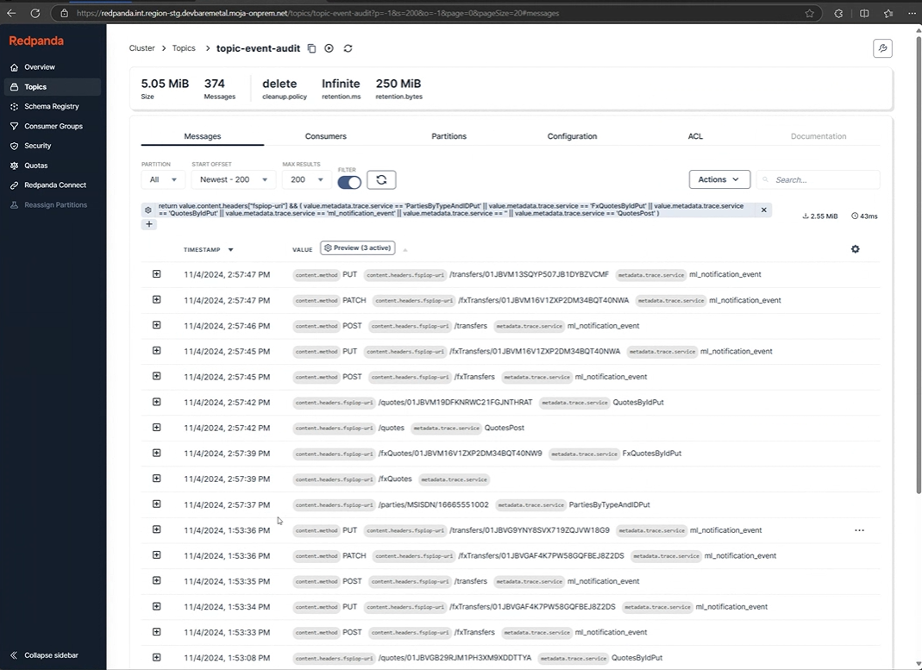
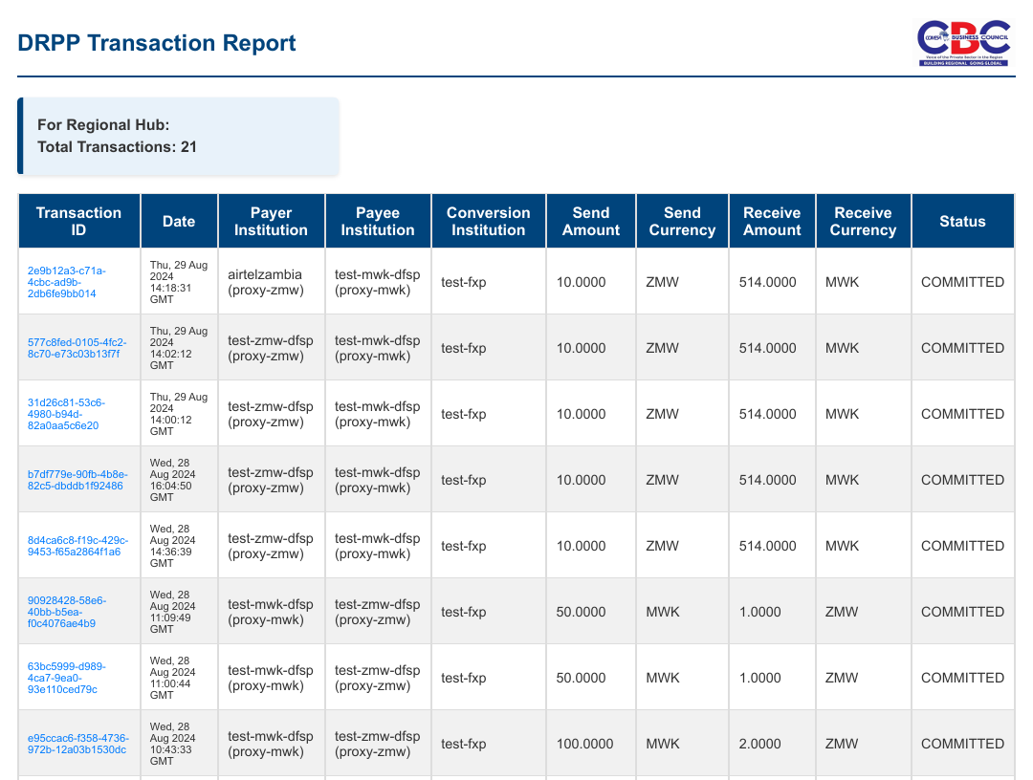
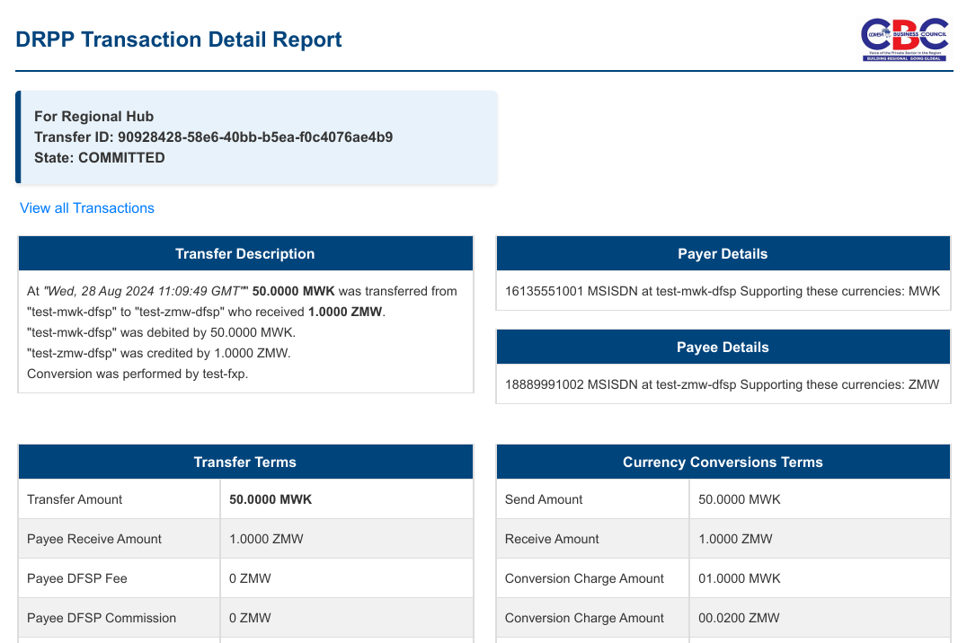
DEMO Reporting
The details of the transaction will be shown via the financial portal report which records the transaction details at the hub.
Finally, we will show the ISO 20022 for IIPS messages in the audit subsystem for 3rd party consumption.
Example Payload reference

Slide 16





Next Steps - Governance Framework
Review and adopt updates to the revised Scheme governance structure to ensure alignment with Treaty, operational standards and regulatory compliance.
Evaluate and endorse proposed foreign exchange models to facilitate cross-border payment efficiency.
Provide feedback on the draft Scheme rule book to refine and solidify its content.
Examine the readiness and functionality of the Scheme’s operational and technical setup.
Formulate recommendations for Bureau endorsement of the Scheme’s deployment.

Slide 17


Next Steps - Soft Launch
A soft launch between Zambia, Malawi, and additional pilot countries with real money and real rail
Will be conducted in a REGULATORY SANDBOX to ensure that the system functions correctly and can handle real-time transactions in a controlled setting.

Slide 18
Next Steps - Going Live
The DRPP will go live by the end of Q1 2025 with all pilot countries after the meeting necessary approvals from the regulators
Will be conducted using actual tangible funds (real money) and established infrastructure that handles actual financial transactions in a live environment (real rail)

Slide 19
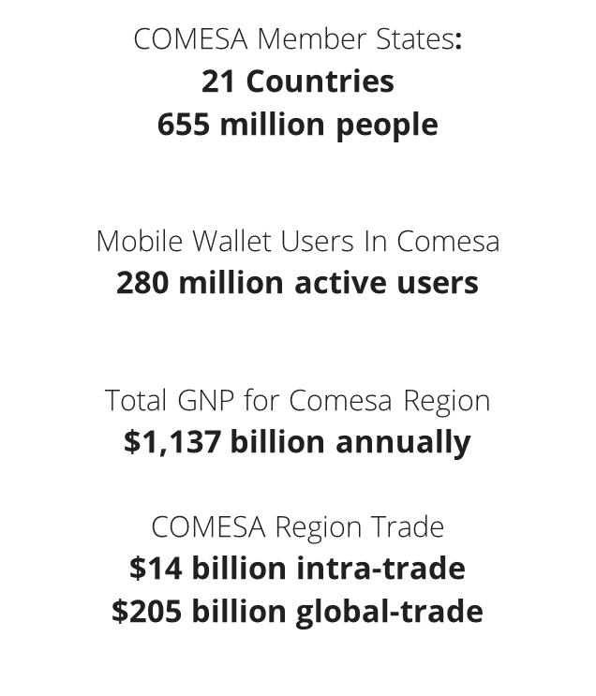
Next Steps – Operational Plan in COMESA
Operational Capacity Plan
Operational Capacity plan
FX Provider Plan
FX Provider plan
Roll-out and Onboarding Plan
Regulatory Oversight

Slide 20






COMESA Business Council, COMESA Building, Right Wing, 2nd Floor, Ben Bella Road, P.O. Box 30051, Lusaka, Zambia
info@comesabusinesscouncil.org
+260 761 228 754 | +260 211 229725/32
@comesabusinesscouncil
@COMESABusiness
@COMESA Business Council
@comesa_business_council_1

Slide 21
Reference Slides

Slide 22
Why is DRPP a valuable offering?
Inclusive Instant Payment System
Process irrevocable push payments, in less than a minute, at a very low-cost and extremely securely, supporting discovery and agreement phases with a cryptographic lock.
Optermised Participation of DFSPs, FXPs and National IIPS
Connect to DRPP with minimal on-boarding and participation costs, providing FIs with a common tools to operate with secure and standard interaction with minimal reconcilliation effort
Competitive Foreign Exchange rates
Create a competitive Market place, with settlement done in Central Bank RTGS, reducing the operating complexity and settlement risks for FXPs thereby contributing to lower costs.
High Quality Inter-Scheme Interoperability
Facilitate interoperability between various payment schemes that are engaged in the processing of the payment transfer, maintaining the non-repudiation of a transaction and reducing settlement risk through pre-funding.
A fraud and risk management service
Process Personal Identifiable Information (PII), using the Tazama Payment Platform Adapter to perform extra risk assessment on top of the DFSPs’ own internal sanction and compliance checks.

Slide 23
Mojaloop ISO 20022 for IIPS
Payer DFSP
Payee DFSP
GET /parties (no payload)
Discovery
Discovery
PUT /parties acmt.024.001.04
1
Mojaloop
POST /fxQuotes pacs.091.001
2
Agreement
Agreement
PUT /quotes
pacs.082.001
POST /quotes
pacs.081.001
3
POST /fxTransfers pacs.009.001.12
Transfers
Transfers
PUT /transfers pacs.002.015
4
POST /transfers pacs.008.013
Agreement
Transfers
PATCH /transfers pacs.002.015
Foreign
Exchange
Provider
ISO20022 for IIPS
PUT /fxQuote pacs.092.001
PUT /fxTransfers pacs.002.015
PATCH /fxTransfers pacs.002.015
Notes:
Before we dive into the demonstration, let’s first outline the mapping between ISO 20022 messages and FSPIOP resources.
In this diagram I have mojaloop in the center, and Payer DFSP on the left, the Payee DFSP on the right, and the foreign exchange provider at the bottom.
In this description I will cover the three phases of a mojaloop transfer, namely the discovery phase, the agreement phase and the transfer phase. Additionally I will show the four steps in a DRPP instant payment cross currency transaction.
The COMESA instant payment process begins with a GET /parties request sent by the Payer DFSP. This request doesn’t contain a payload, so no ISO 20022 message equivalent is required.
Upon receiving this request, the Payee DFSP responds with an ISO 20022 Account Identification Verification Report, which is received by the Payer DFSP.
Next, the Payer DFSP sends a Financial Institution Credit Transfer Quote Request, introducing a new ISO 20022 message type. The FXP responds with a Financial Institution Credit Transfer Quote Response, also a new ISO 20022 message.
Following this, the Payer DFSP sends a FI-to-FI Customer Credit Quote Request, yet another new ISO 20022 message. The Payee DFSP receives this request and replies with a FI-to-FI Customer Credit Quote Response.
The Payer DFSP then initiates a FI-to-FI Customer Credit Transfer, which represents an updated version of an existing ISO 20022 message. The Payee DFSP responds with an FI-to-FI Payment Status Report, also a revised version of an existing ISO 20022 message.
Finally, the FXP and the Payee DFSP are notified of the completed transfer via a final FI-to-FI Payment Status Report message.

Slide 24

Milestone #2 Project Progress
Milestone #
The demonstration today has shown the full end-to-end clearance flows on a on-premise staging environment
Repeatable COMESA Configuration Deploys
The control center has resilience and profiling enhancements that allow deployment and management of the DRPP Administrative Boundary, and has been used to deploy environments including:
Regional Multi-currency hub (region-stg)
Two Jurisdictional “Single-Currency” emulated NIIPS (eNIIPS) for
Mawali - mwk-stg
Zambia - zmw-stg,
An aggregate environment for DFSP connectivity through Payment Managers
pm-stg
Mojaloop Inter-scheme Functionality
Enhancements to allow interoperability between IIPS enabled switches have been realised in the Core Mojaloop platform, this includes:
The Proxy component that provides resilient and secure interconnectivity
Changes to the core Mojaloop functionality that allows routing via proxies
This is used to provide interoperability between the Zambia and Malawi eNIIPS and the DRPP Hub.
Mojaloop Currency Conversion Functionality
Enhancements to allow the Core and participation tools to process the FX algorithm. In particular, FX Providers are able to connect to the regional hub and service Payer requests for liquidity cover
Simulated FXP provides liquidity cover to the
FXP provides quote to payer DFSP to fix forex rate for transaction
FXP provides liquidity cover of the
DFSP Integration
Local capacity has been built with iZyane and iMoSys being trained up to leverage Mojaloop Participation Tools and the resultant creation of custom core Connectors
Zambia Airtel: core connector built and integrated with Airtel Staging system
TNM Malawi: core connector built and backend simulated used TTK, waiting on TNM
Pipeline to support: MTN, FDH (for FXP too)
4
4
4
4
4
/
/
3
4
5
3
4

Slide 25
Milestone #3 Project Progress
Milestone #
The demonstration today has shown the full end-to-end clearance flows on a on-premise staging environment
Mojaloop ISO 20022 for IIPS
The mojaloop components have been updated to make use of the ISO 20022 message payloads. Achieving this has required changes to the following:
Account Lookup Service
Quoting Service
Transfer service handlers
ML-API Adapter
Notification Handler
Testing Toolkit - to support Mojaloop Golden Path Tests in ISO 20022
Payment Manager ISO 20022 support
Enhancements of Participation Tools to allow ISO20022 payloads. Realising this has required changes to the following:
Mojaloop Connector ISO 20022
Payment Manager ISO 20022
FRMS readiness with ISO 20022 messages
Services enhanced to support audits on the ISO 20022 messages
Account Lookup Service
Quoting Service
Transfer service handlers
ML-API Adapter
Notification Handler
4
4
4
4
4
/
/
3
4
5
4
Notes:
Thanks, Vijaya.
Let’s conclude this demonstration by summarizing our progress on the project. So, what have we achieved?
We’ve successfully configured and deployed repeatable, standardized solutions.
This includes establishing a regional multi-currency hub and jurisdictional hubs that operate in single currencies. Additionally, we’ve integrated multi-scheme functionality, which supports end-to-end non-repudiation. We’ve implemented new currency conversion capabilities, enabling foreign exchange providers to offer cross-currency liquidity. Furthermore, we’ve completed DFS provider integrations, including an integration in Zambia for Airtel.
On the right side of this slide is our functional checklist. I’ve marked all the elements that have been completed and showcased in this demonstration. The end-to-end cross-currency transactions work is complete with some remaining work on the visualization components. The core inter-scheme end-to-end functionality is now complete.

Slide 26

Build Phase
DRPP Administrative Boundary
Regional
IIPS
$
Regional Central Bank
Settlement Provider
FX Provider
Supported
Supported
FRMS /
eCommerce
Participating Country
Participating Country
FRMS
Citizen / Merchant
DFSP
Domestic
IIPS
Proxy
Proxy
Domestic
IIPS
DFSP
Citizen /
Merchant
Proxy
Proxy
Zambia
Malawi
FI Administrative Boundary
FI Administrative Boundary
Emulated
National IIPS
(Mojaloop)
Emulated
National IIPS
(Mojaloop)
Payment
Manager
Payment
Manager
Payer
Source DFSP
Destination DFSP
Payee
Existing
national system
Existing
national system
Notes:
An IIPS will be deployed domestically to process cross-border payments. DFSPs that wish to connect to the regional hub will do so via this IIPS, which acts as an emulated/buffer scheme of the regional hub and can be considered as an administrative boundary of the regional hub (DRPP)
Note: Domestic transfers can be processed via the IIPS.

